Slide 1
Home Camera-Based Fall Detection System for the Elderly
Koldo de Miguel, Alberto Brunete, Miguel Hernando and Ernesto Gambao
Multidisciplinary Digital Publishing Institute (MDPI)
Sensors 2017

Slide 2
abstract
fall detectors based on artificial vision
low cost
-> not yet available on the market
Using
background subtraction
Kalman filtering and optical flow

Slide 3
1. introduce
7 million dementia patients in Europe alone
double every 20 years
improves their independence, comfort and safety and prevents depression
frees caregivers

Slide 4
Accident detect -> send message
low-cost device like a Raspberry Pi

Slide 5
2.1 wearable sensors
Use accelerometers and gyroscopes
inside the wearer’s ear.
electromyographic (EMG) sensors (근전도)

Slide 6
2.2. Ambient Devices
vibration sensors
laser-emitting component
Audio
Wearable airbag

Slide 7
2.3. Vision-Based Devices
sends only images when the fall has been detected.
merge cameras (Microsoft’s Kinect) and accelerometera

Slide 8
2.3.1. Cameras
body and shape change, posture detection, inactivity, spatiotemporal and 3D head change.

Slide 9
2.3.2. Processing Units
high computational processing power
expensive hardware
This paper use Raspberry Pi

Slide 10
2.3.3. Relevant Information Segmentation
subtraction of a background image
identify certain features of the human body(ex. Head)

Slide 11
2.3.4. Subject Tracking
simplified colour based algorithm
person’s head, body and legs are easily differentiable

Slide 12
2.3.5. Data Modelling
rectangles and ellipses -> easy sampling

Slide 13
2.3.6. State Classification
rules and data thresholds
K-Nearest Neighbours and Support Vector Machines
Artificial Neural Networks and Hidden Markov Models

Slide 14
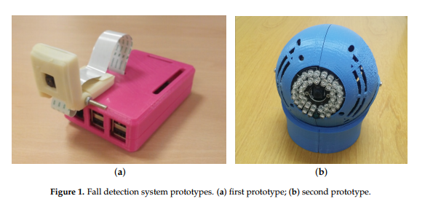
3. Description of the Hardware

Slide 15
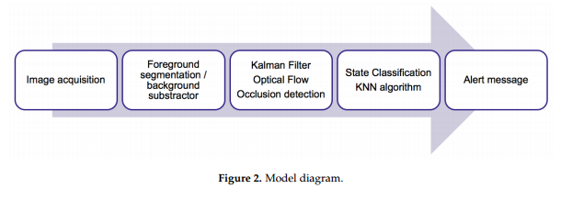
4. Fall Detection Algorithm

Slide 16
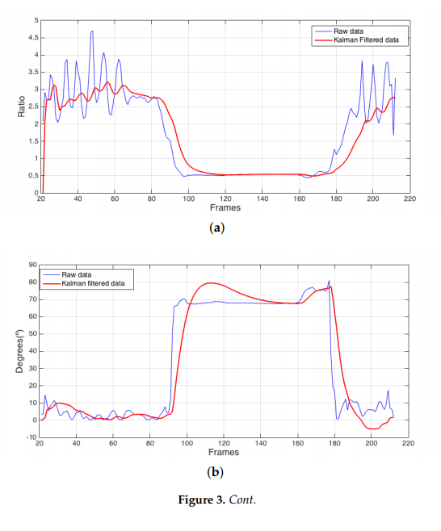
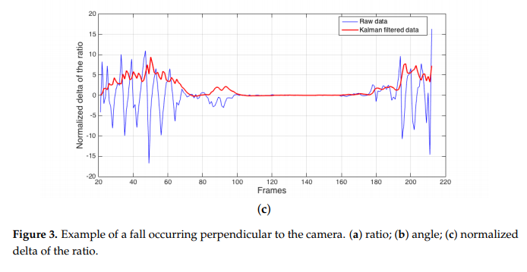
4.1. Data Model
The angle refers to the angle between the x-axis and the major-axis of an ellipse enclosing the subject.
The ratio refers to the relationship between the width and height of a rectangle that encloses the subject.

Slide 17
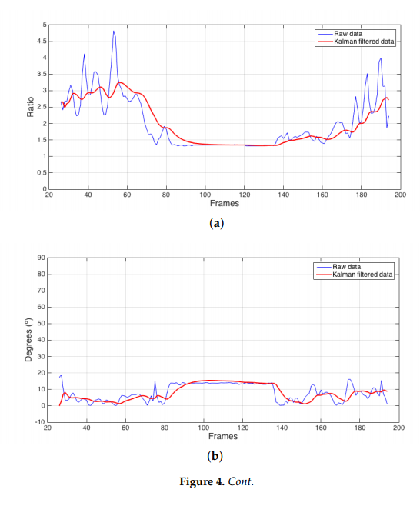
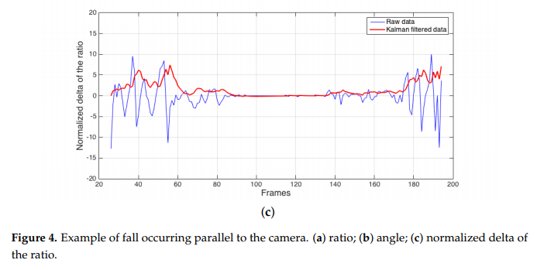

Slide 18
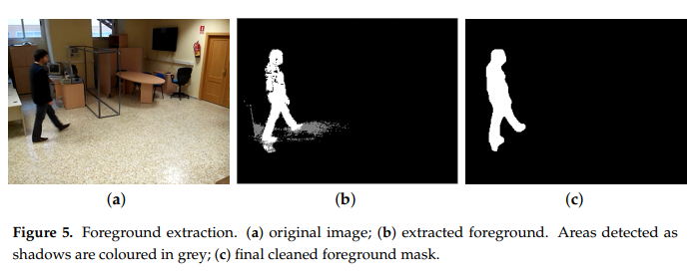
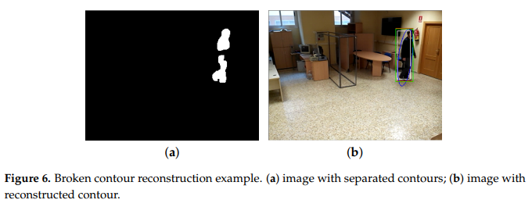
4.2. Background Subtractor

Slide 19
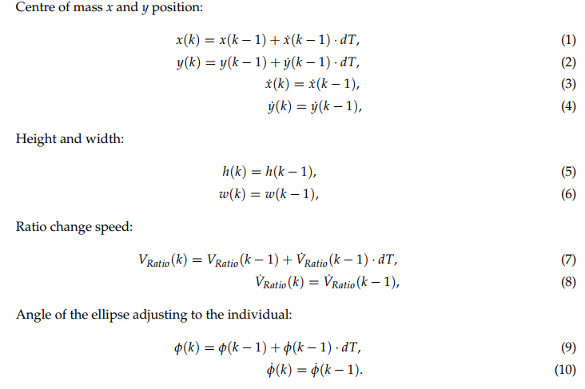
4.3. Kalman Filter

Slide 20
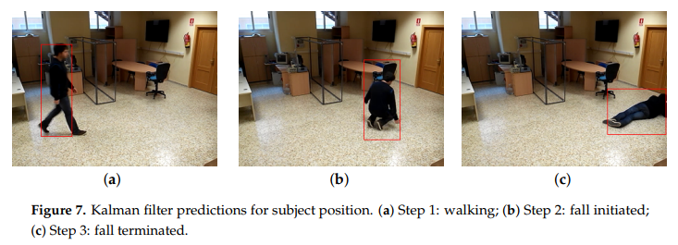

Slide 21
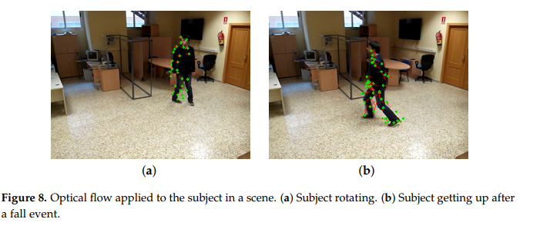
4.4. Optical Flow
sensitive enough to detect even small movements

Slide 22
4.5. State Classification
The KNN algorithm
the angle
subject ratio
three most recent values for ratio change speed as input.

Slide 23
Twofold(ratio speed change)
weighted to reduce the influence of the otherwise triplicated ratio change speed
the addition of a calmness condition to the fallen state
(small movements to seizure-like movements)
avoids inconsistent state transition phases

Slide 24
Future version use support vector machines (SVM)

Slide 25
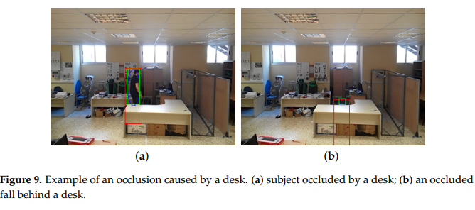
4.6. Occlusions

Slide 26
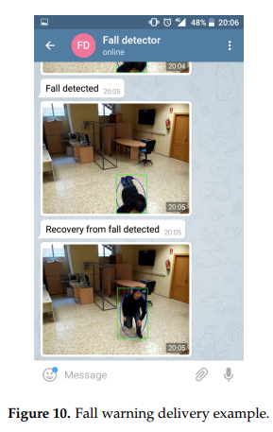
4.7. Alert System

Slide 27
5. System Installation
Camera installed at height of 2 to 2.25 m , 14◦± 5◦
Must not towards TVs or reflective objects and bright windows
The entire flat can be covered with six cameras.

Slide 28
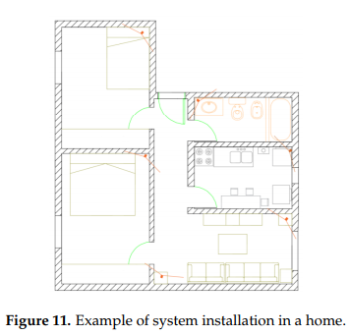

Slide 29
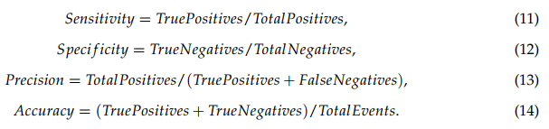
6. Results and Discussion

Slide 30
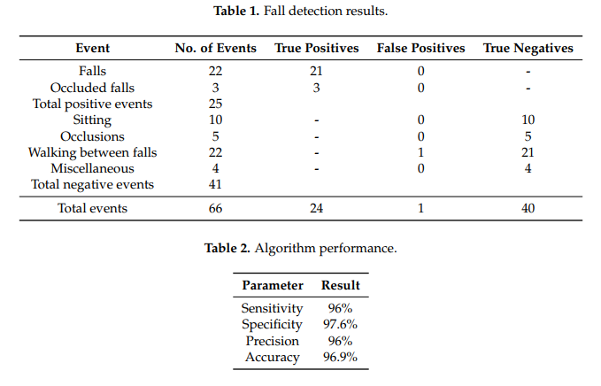

Slide 31
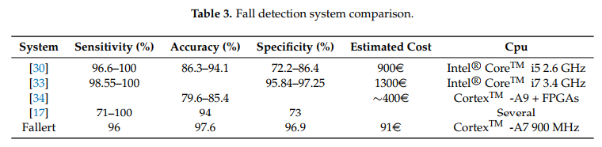

Slide 32
different algorithms
->> other states such as walking and sitting.

